Slide 1

CAPSTONE PROJECT
ONLINE RETAIL CUSTOMER
SEGMENTATION

Slide 2
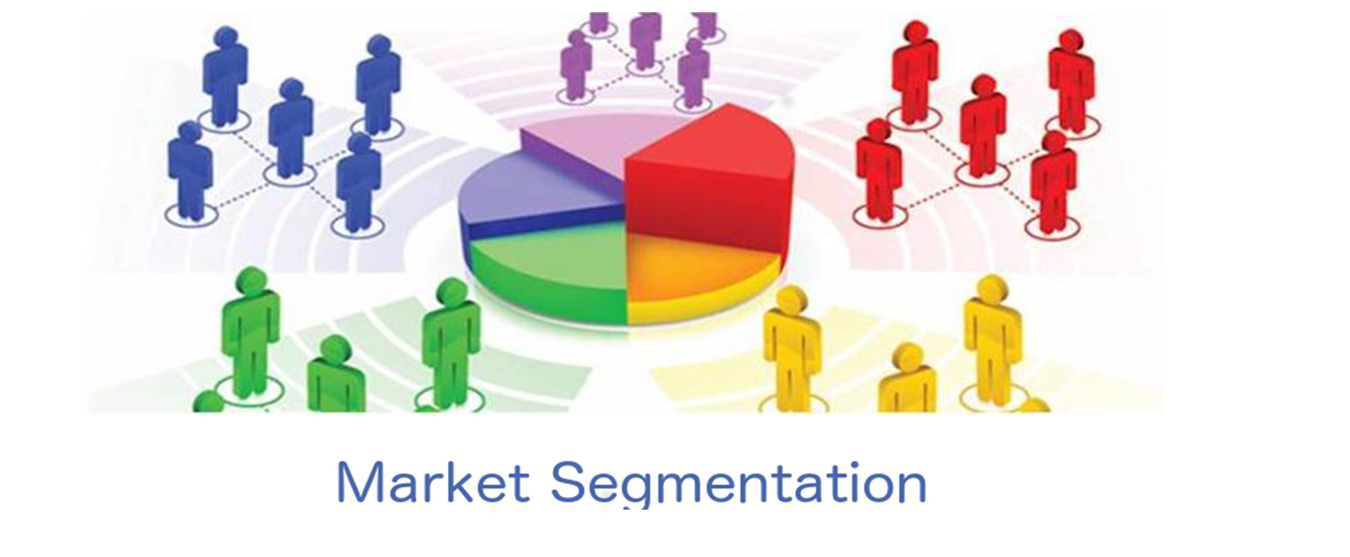
ONLINE RETAIL CUSTOMER SEGMENTATION

Slide 3
About Online retail customer
Online retail customer segmentation is used to identify customer purchase behaviour, where it uses customer purchase data to know customer needs and apply them on business fields in order to increase sales and profits and to meet the requirements of the people.
This is an effective method for managing customers while developing diverse
marketing strategies.
In this the customers are divided into homogeneous and distinct groups where it is tracked online helped by certain algorithm so that we can identify and separate the customers according to their purchase pattern.
Company need to focus the target or recently or else frequently purchasing customers to gain maximize profit with win –win situation for company-customer.
Customer segmentation is one of the solution to optimize the result of win –win situation.

Slide 4
PROBLEM STATEMENT
In this project, our task is to identify major customer segments on a transnational dataset which contains all the transactions occurring between 01/12/2010 and 09/12/2011 for a UK-based and registered non-store online retail. The company mainly sells unique all-occasion gifts. Many customers of the company are wholesalers.

Slide 5
DATA DESCRIPTION
Attribute Information:
InvoiceNo: Invoice number. Nominal, a 6-digit integral number uniquely assigned to each transaction. If this code starts with letter 'c', it indicates a cancellation.
StockCode: Product (item) code. Nominal, a 5-digit integral number uniquely
assigned to each distinct product.
Description: Product (item) name. Nominal.
Quantity: The quantities of each product (item) per transaction. Numeric.
InvoiceDate: Invoice Date and time. Numeric, the day and time when each
transaction was generated.
UnitPrice: Unit price. Numeric, Product price per unit in sterling.
CustomerID: Customer number. Nominal, a 5-digit integral number uniquely assigned to each customer.
Country: Country name. Nominal, the name of the country where each customer resides.

Slide 6
INTRODUCTION
Customer segmentation is the process of separating customers into groups based on their shared behavior or other attributes. The groups should be homogeneous within themselves and should also be heterogeneous to each other.
The main goal is to identify customers that are most profitable and the ones who churned out to prevent further loss of customer by redefining company policies.
Having large number of customers, each with different needs it is crucial to find which customer are most important for business and target them with appropriate strategy.

Slide 7
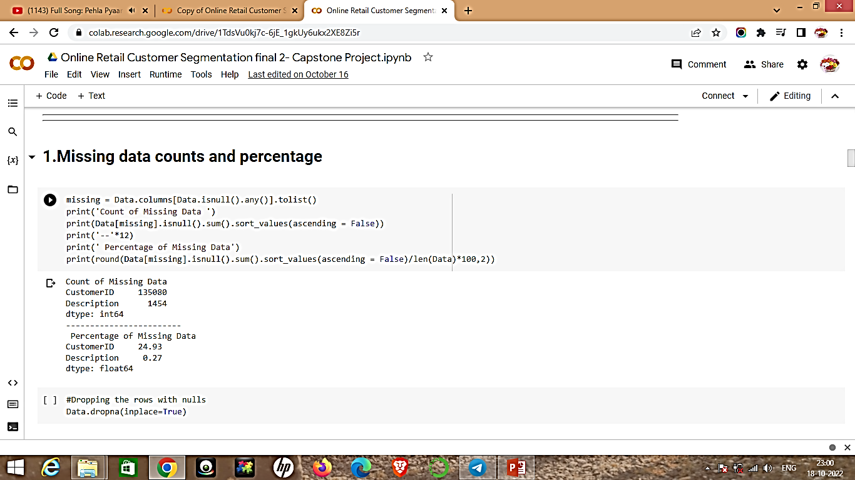
IMPORTING AND INSPECTING DATASET
The dataset contain 541909 records and 8 columns.
Number of unique values in each column is as follows:
There are some missing values in the Description and CustomerID column:
Description – 135080 (24.93% Missing Values)
CustomerID – 1454 (0.27% Missing Values)
There are 5225 duplicate rows in the dataset.

Slide 8
DATA CLEANING
We dropped the rows with missing values from the dataset because if the CustomerID and Description is not present, other features in that row can not be used to identify the customer hence its meaningless to assign that datapoint to any cluster.
We also dropped the duplicate rows from the dataset so the final shape of the dataset is 401604 records with 8 columns.

Slide 9
FEATURE ENGINEERING
Created some new features named Year, Month, Day and Hour by extracting different time intervals from the InvoiceDate column which was of the datetime datatype.
Created a new feature named 'TotalAmount' by multiplying values from
Quantity and UnitPrice column.
Created a new feature 'TimeType' based on hours to define whether its
Morning, Afternoon or Evening
The InvoiceNo starting with 'C' represents cancellation hence we dropped all such rows as we are interested in the valid transactions only.

Slide 10
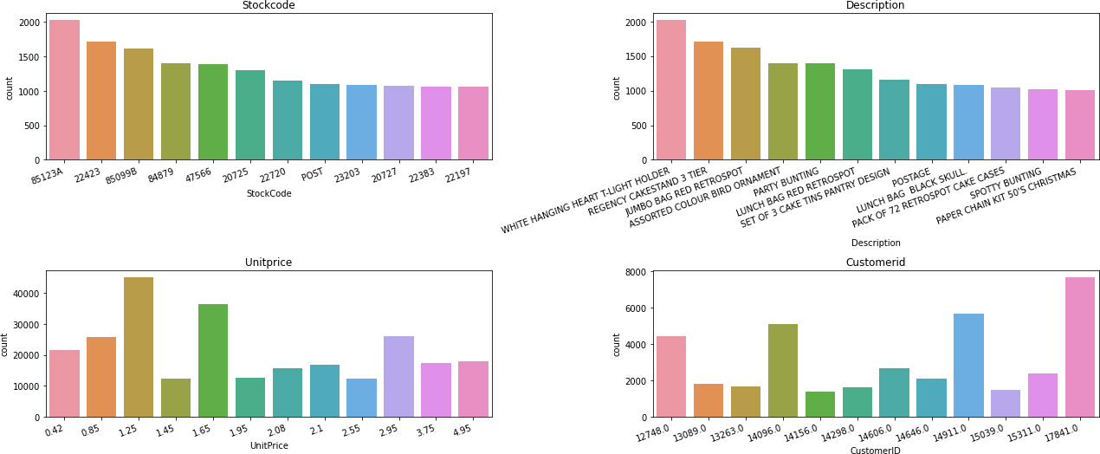
EDA- MOST FREQUENT VALUES

Slide 11
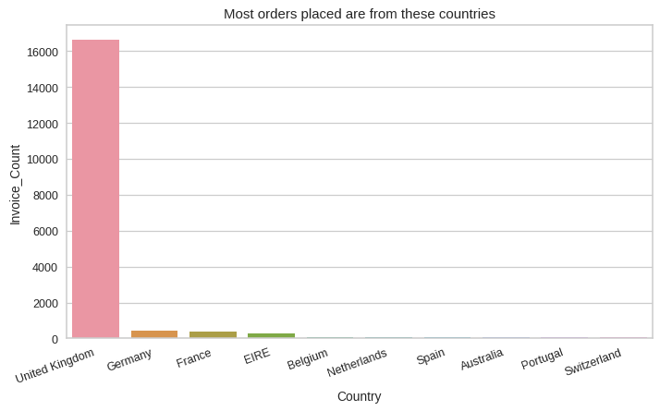
1.Which country has most count in number of orders
From the plotting of data we can say that
From the country of United Kingdom
most orders are placed .
United Kingdom has most number of orders
With a count of more than 16000.
Remaining countries like Germany ,France and
EIRE has minimum number of orders to very least count.

Slide 12
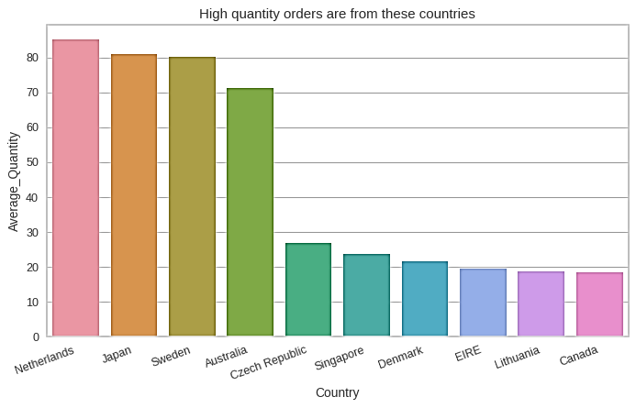
2.The country with high quantity number of orders
First country with high quantity of orders is from
Netherlands with a count of 80 above.
Second country with high quantity of orders is from
the country of Japan with a count of 80.
Third country with high quantity of orders is from
The country of Sweden with a count near to 80.
Countries like Australia ,Czech Republic ,Singapore ,
Denmark , EIRE, Lithuania, Canada has least quantity
Number of orders.

Slide 13
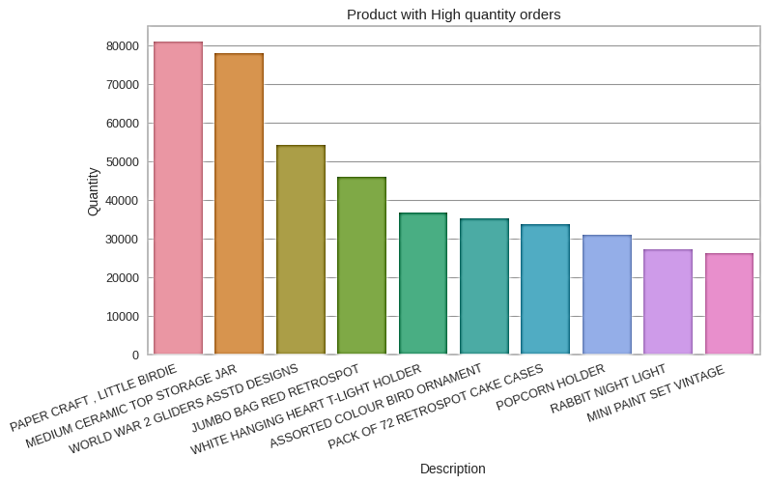
3.Product with high quantity orders
The product with high quantity of order is Paper Craft Little Birdie with a count of 80000.
The next product with high quantity order is Medium Ceramic Top Storage Jar Of nearly 80000 count.
Other products with high quantity order are less In the count of orders.

Slide 14
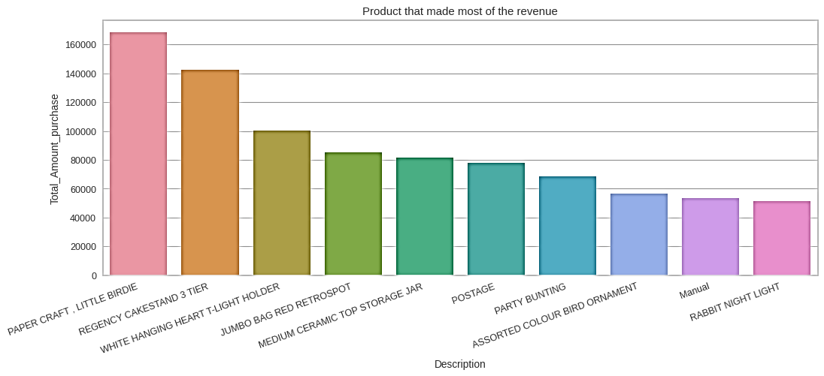
4.Product that made most of the revenue
Product that made most of the profit in terms of revenue is Paper Craft Little Bride.With more than the count of 160000.
The next second product with most of the profit it made is about 140000 of product named Regency Cake Stand 3 tier.

Slide 15
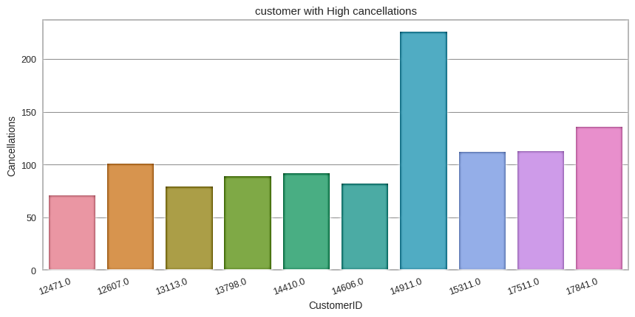
5.Customer with high cancellations
The customer id with most number of cancellations is 149110.
The next customer id with most number of cancellation is 178410.
The third customer id with most number of cancellations is 175110 and other id number 153110.

Slide 16
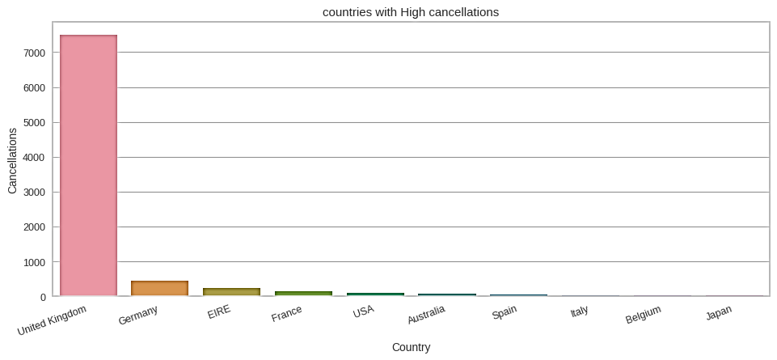
6.Country with high cancellations
Country with highest number of cancellation is United Kingdom with a Count of more than 7000.
The other countries has least number of cancellations.

Slide 17
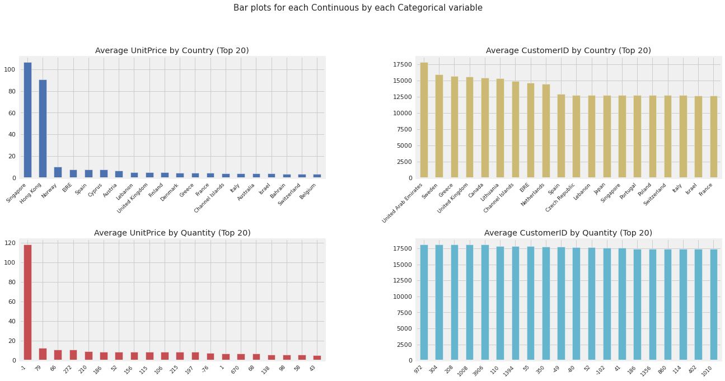
EDA-Autoviz
Autoviz module in python
it is an automated visualization library that automatically searches for important features from the dataset and plots impactful charts. Also, it is now possible to save these interactive plots as HTML files with the "html" setting

Slide 18
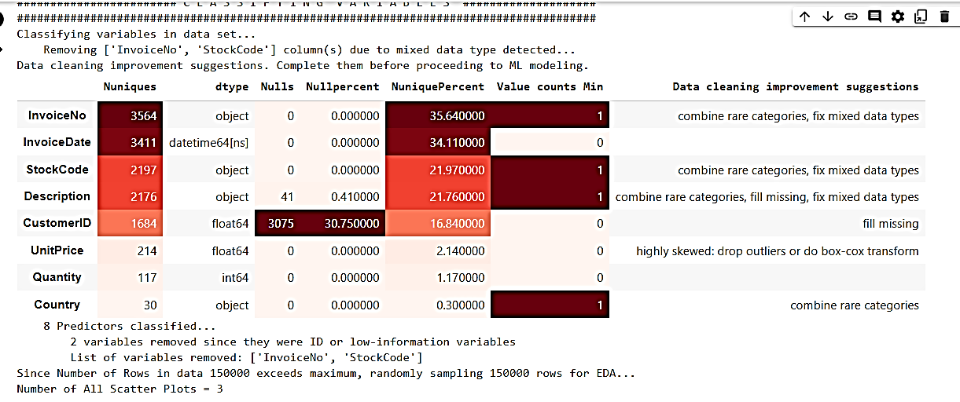
EDA-Autoviz

Slide 19
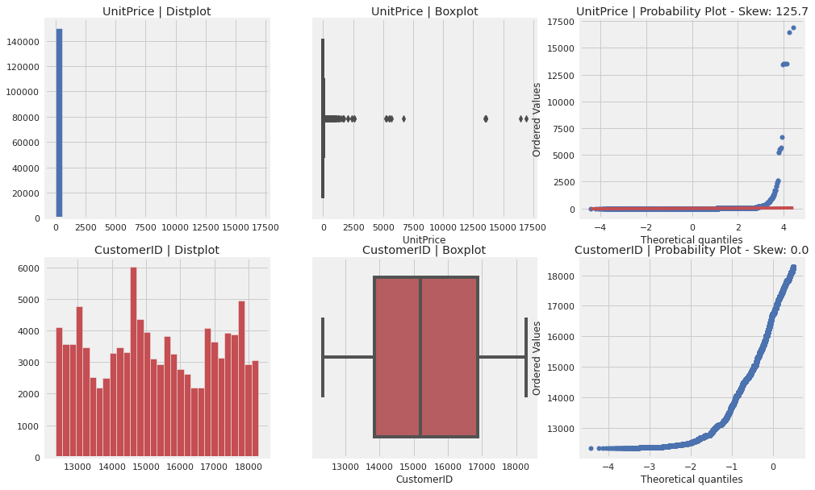
Autoviz

Slide 20
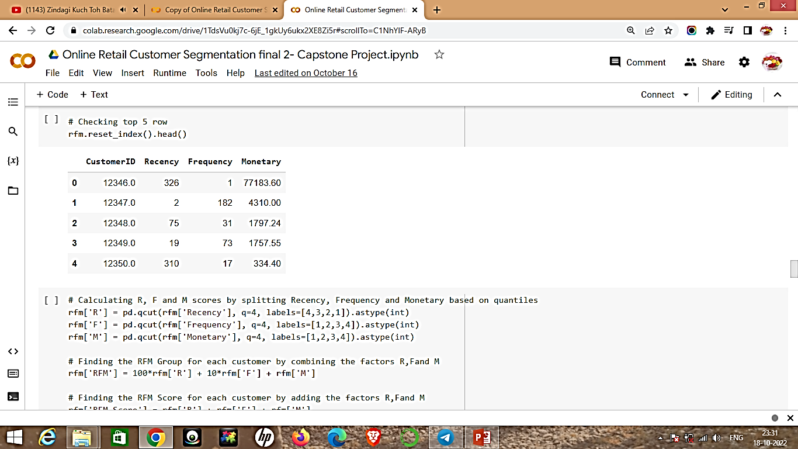
RFM MODELLING
1. Recency: How recent a customer made a purchase.
2. Frequency: How often a customer makes a purchase.
3. Monetary: How much money a customer spends.
We divided Recency, Frequency and Monetary columns in 4 categories based on quantiles to come up with new 3 features named R, F, and M.

Slide 21
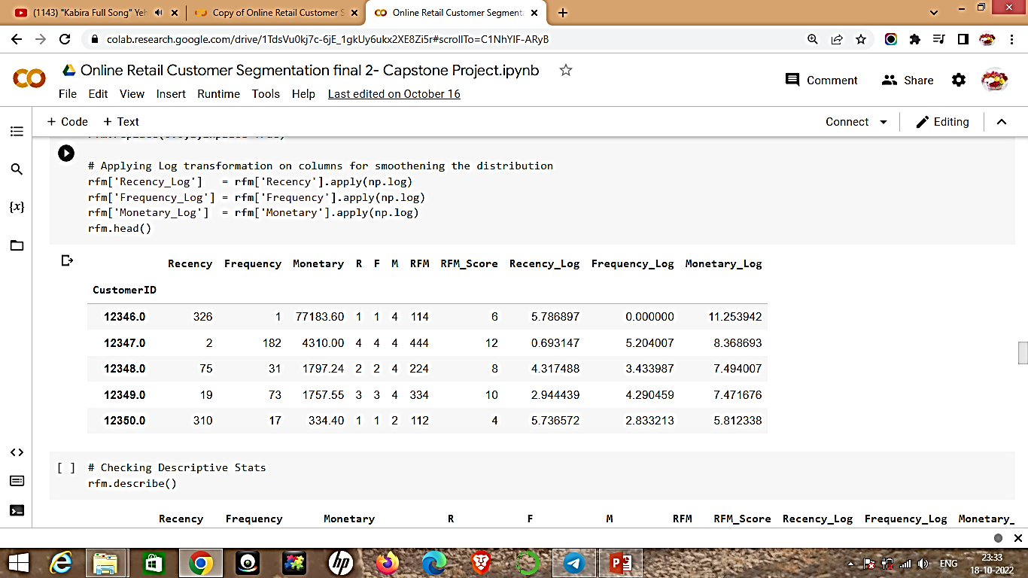
RFM MODELLING
Finally we created a new feature named RFM by concatenating the factors R, F and M. The
values in this column range from 111(lowest) to 444(highest).
If the RFM of any customer is 444. His Recency is good, frequency is more and Monetary is more. So, he is a Big spender.
If the RFM of any customer is 111. His Recency is low, frequency is low and Monetary is low. So, he is a little spender.
If the RFM of any customer is 144. He purchased a long time ago but buys frequently and spends more. And so on.

Slide 22
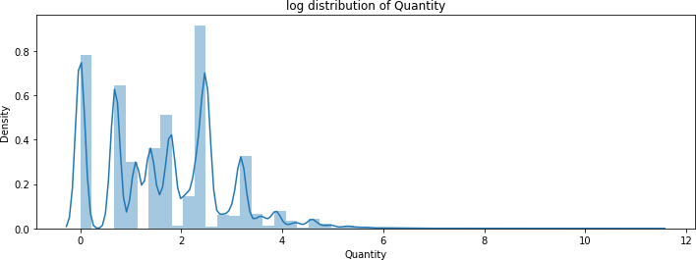
LOG TRANSFORMATION
After applying log transformation now the distribution plot looks comparatively better
than being skewed.
We use log transformation when our original continuous data does not follow the bell curve, we can log transform this data to make it as “normal” as possible so that the analysis results from this data become more valid.

Slide 23
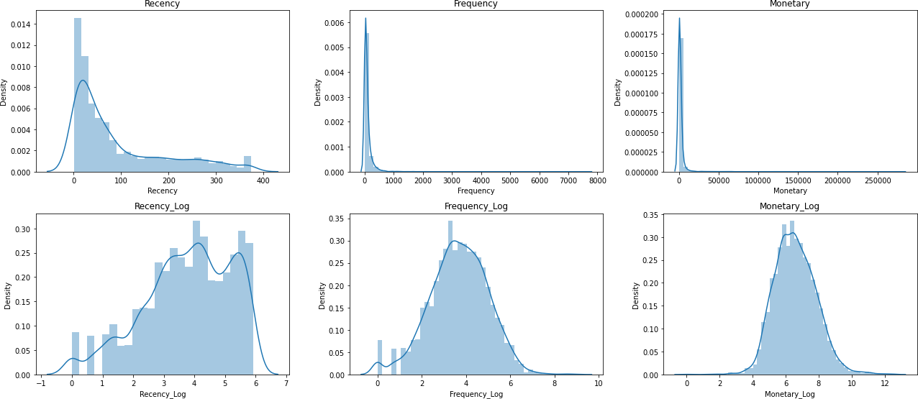
RFM MODELLING
Earlier the distributions of Recency, Frequency and Monetary columns were positively skewed but after applying log transformation, the distributions appear to be symmetrical and normally distributed.
It will be more suitable to use the transformed features for better visualization of clusters.

Slide 24
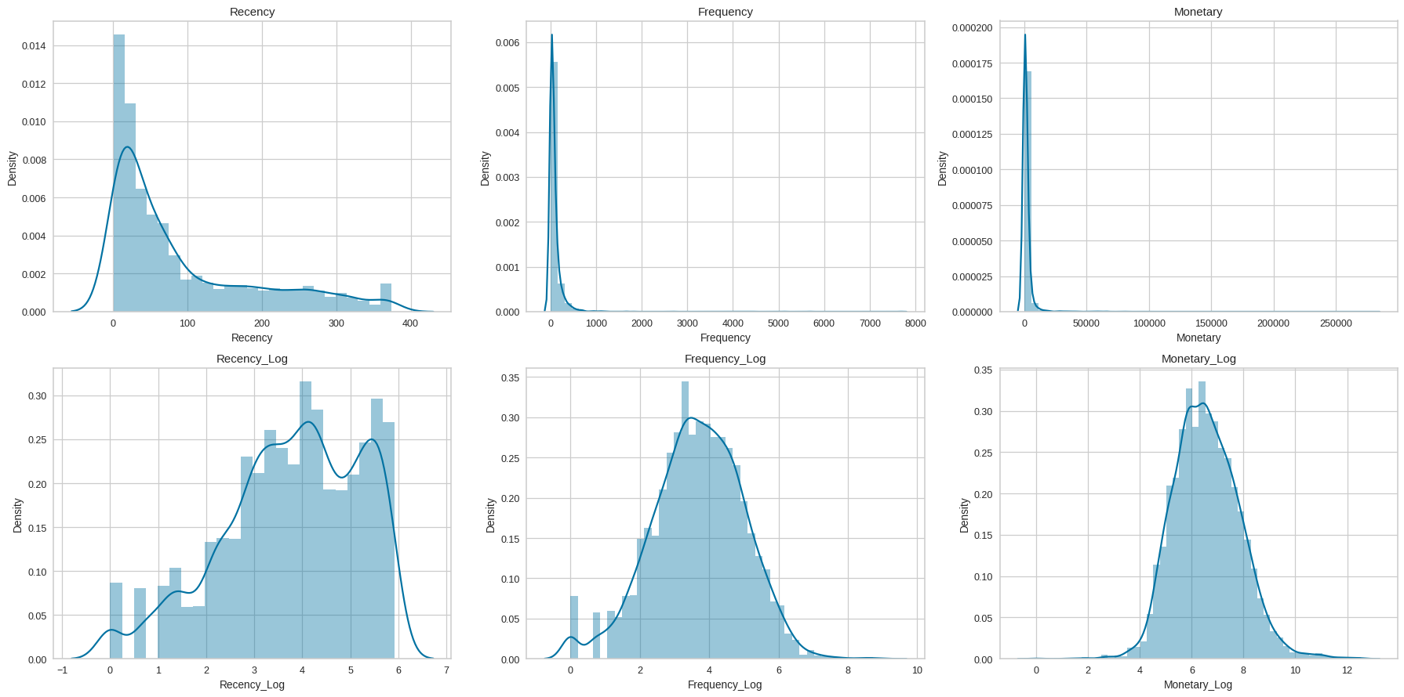
Normal Distribution for RFM

Slide 25
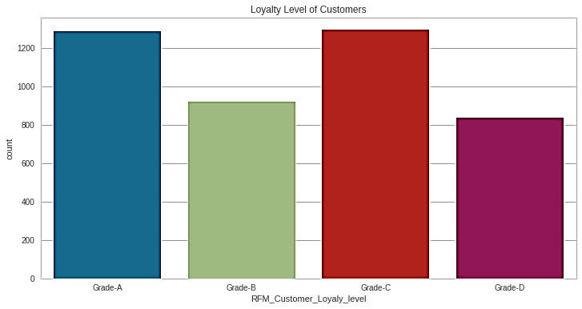
RFM - Loyalty level of Customers
According to RFM_Customer_Loyal_level Grade-A and Grade-C loyalty of customers are high in the count of 1200 and above .
Grade –B loyalty customers were nearly 850.
Grade-c loyalty customers were nearly 800.

Slide 26
CLUSTERING PREREQUISITES
Defining the X variables i.e. the log transformed Recency, Frequency and
Monetary values.
Applied StandardScaler on X variables. Standard Scaler helps to get standardized distribution, with a zero mean and standard deviation of one (unit variance). It standardizes features by subtracting the mean value from the feature and then dividing the result by feature standard deviation.
Defining a function which takes predicted y labels as input and plots 3d visualization of clusters.

Slide 27
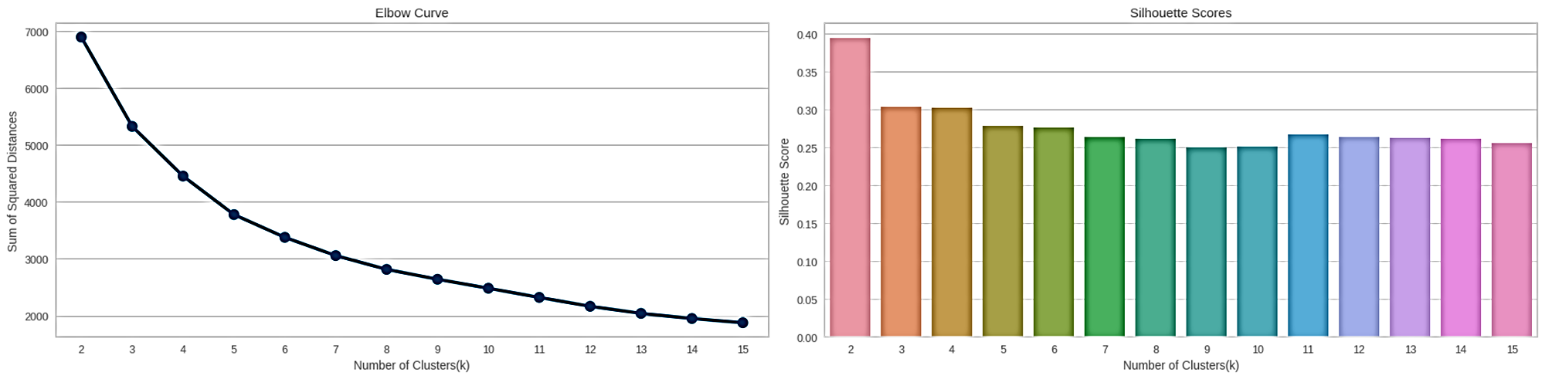
K-Means - Clustering
If we look at both of the graphs at the same time to decide the optimal number of clusters, we can take the intersection of set of good n_clusters obtained from both the graphs. So 4 appears to be a good choice, having a decent Silhouette score as well as near the elbow of the elbow curve

Slide 28
K-Means - Clustering
1.Fitting the model on n_clusters = 2 based on Silhouette_Score to visualise the segments.
2.Fitting the model on n_clusters = 5 based on Elbow_Curve
3.Fitting the model on n_clusters = 4 based on Both Elbow_Curve & Silhouette_Score to visualise the segments.

Slide 29
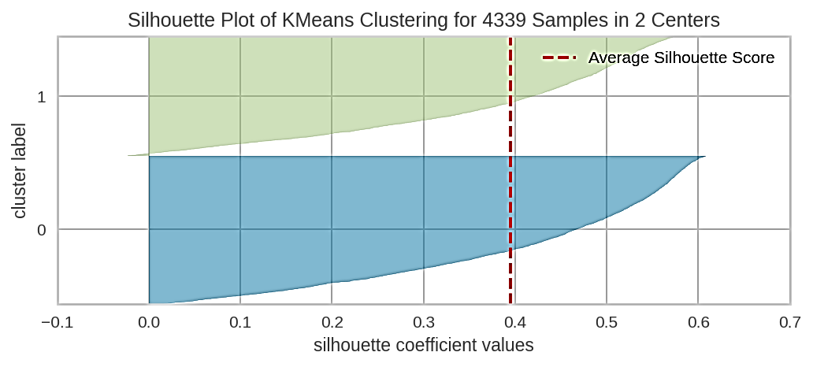
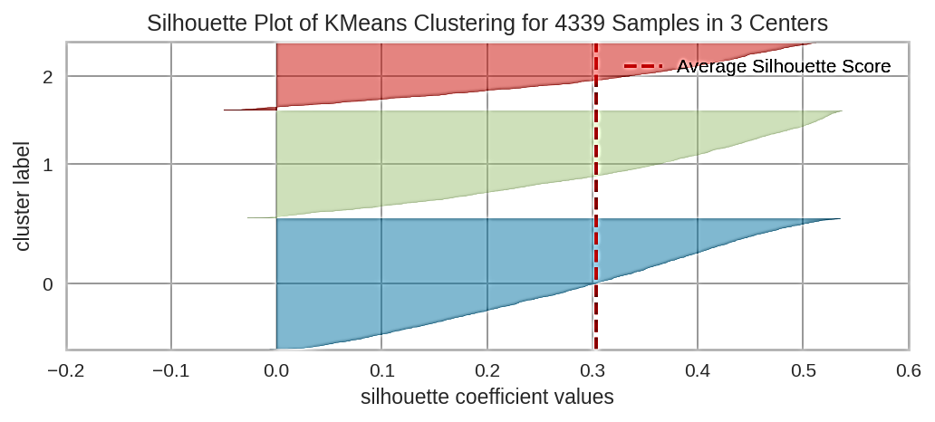
Silouette plots for the clusters

Slide 30
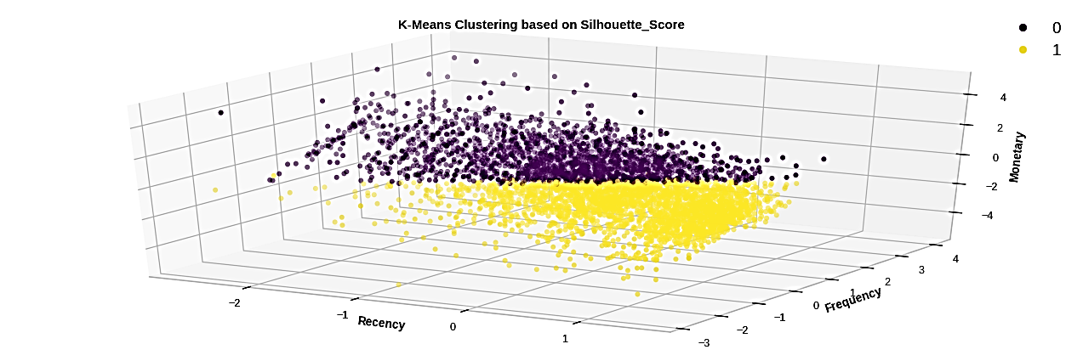
1.Fitting the model on n_clusters = 2 based on Silhouette_Score to visualise the segments.

Slide 31
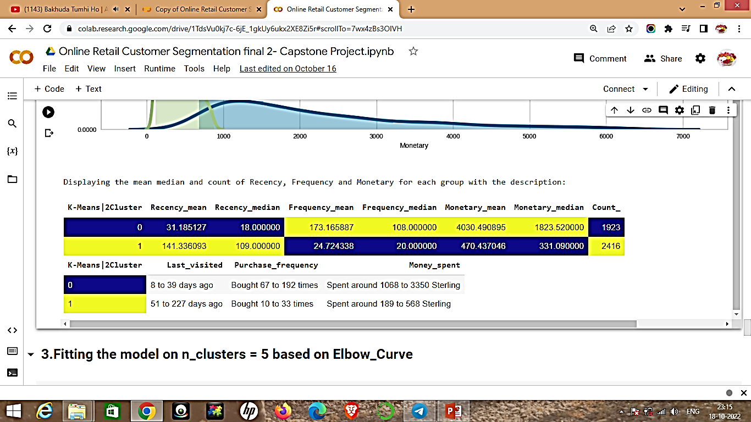
Displaying the mean median and count of Recency, Frequency and Monetary for each group with the description

Slide 32
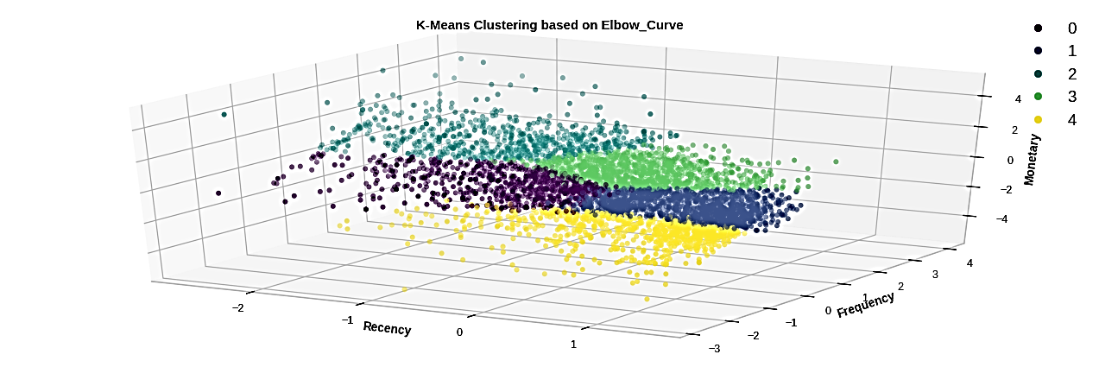
2.Fitting the model on n_clusters = 5 based on Elbow_Curve

Slide 33
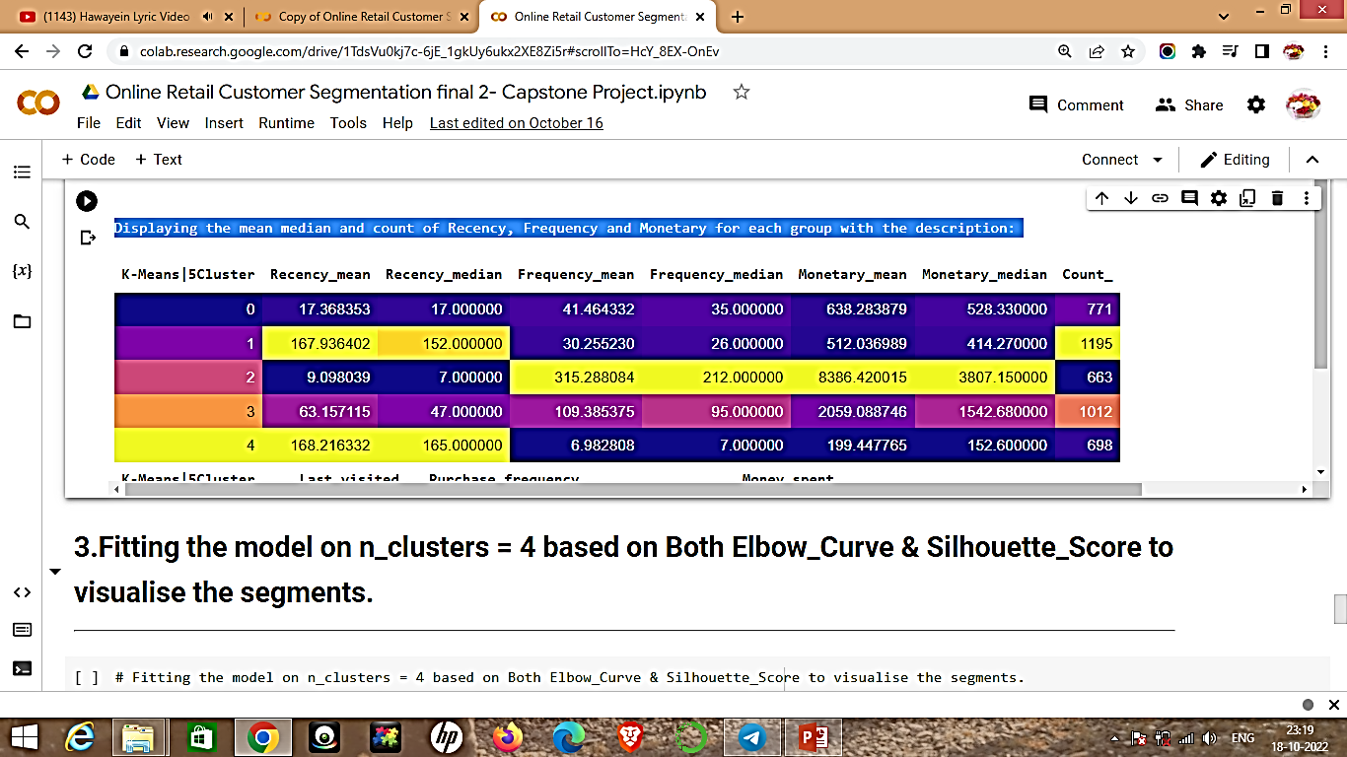
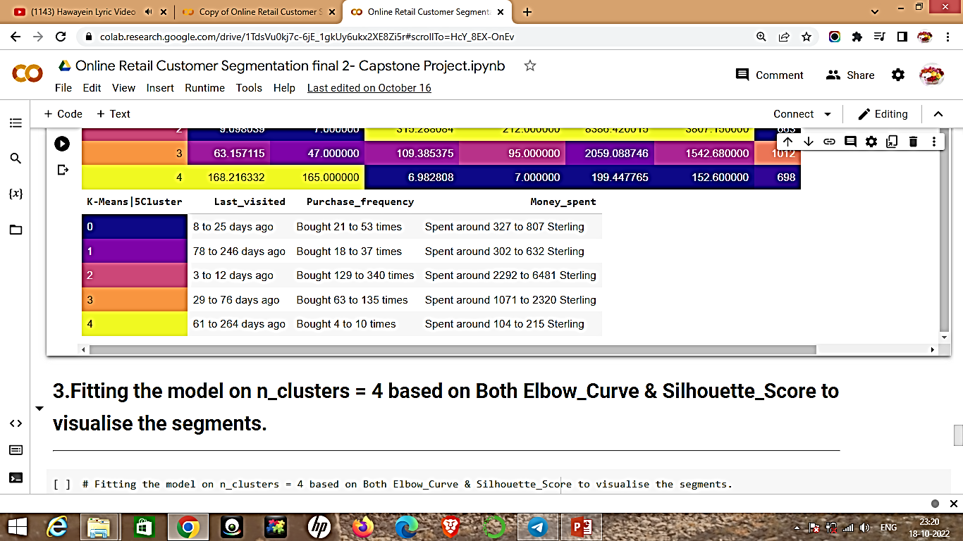
Displaying the mean median and count of Recency, Frequency and Monetary for each group with the description:

Slide 34
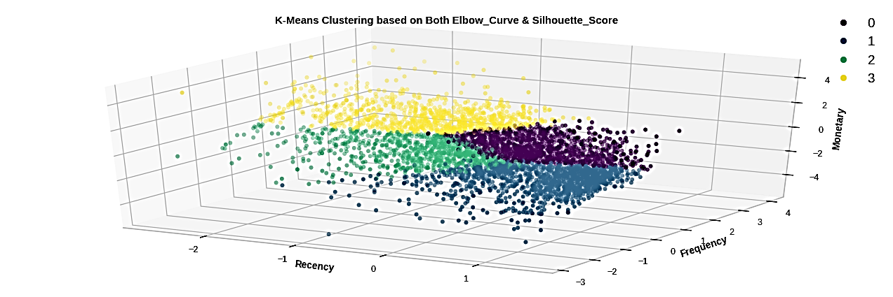
3.Fitting the model on n_clusters = 4 based on Both Elbow_Curve & Silhouette_Score to visualise the segments.

Slide 35
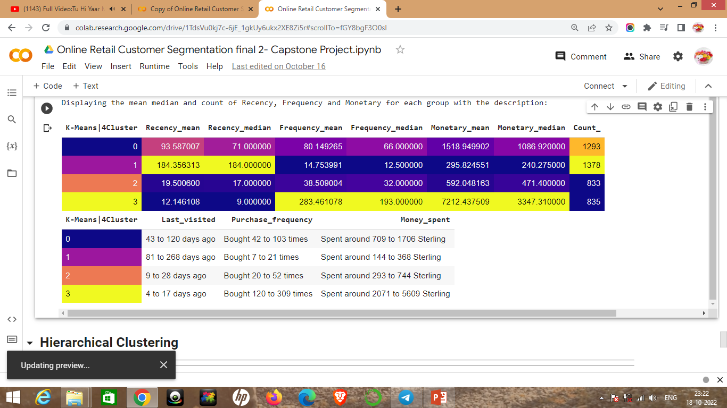
Displaying the mean median and count of Recency, Frequency and Monetary for each group with the description:

Slide 36
HIERARCHICAL CLUSTERING
We can set a threshold distance and draw a horizontal line (Generally, we try to set the threshold in such a way that it cuts the tallest vertical line). We can set this threshold as 50 or 70 and draw a horizontal line as shown in dendogram in the previous slide..
The number of clusters will be the number of vertical lines which are being intersected by the line drawn using the threshold. The larger threshold (y=70) results in 2 clusters while the smaller (y=50) results in 3 clusters.
Lets visualize the clusters in the next slide.

Slide 37
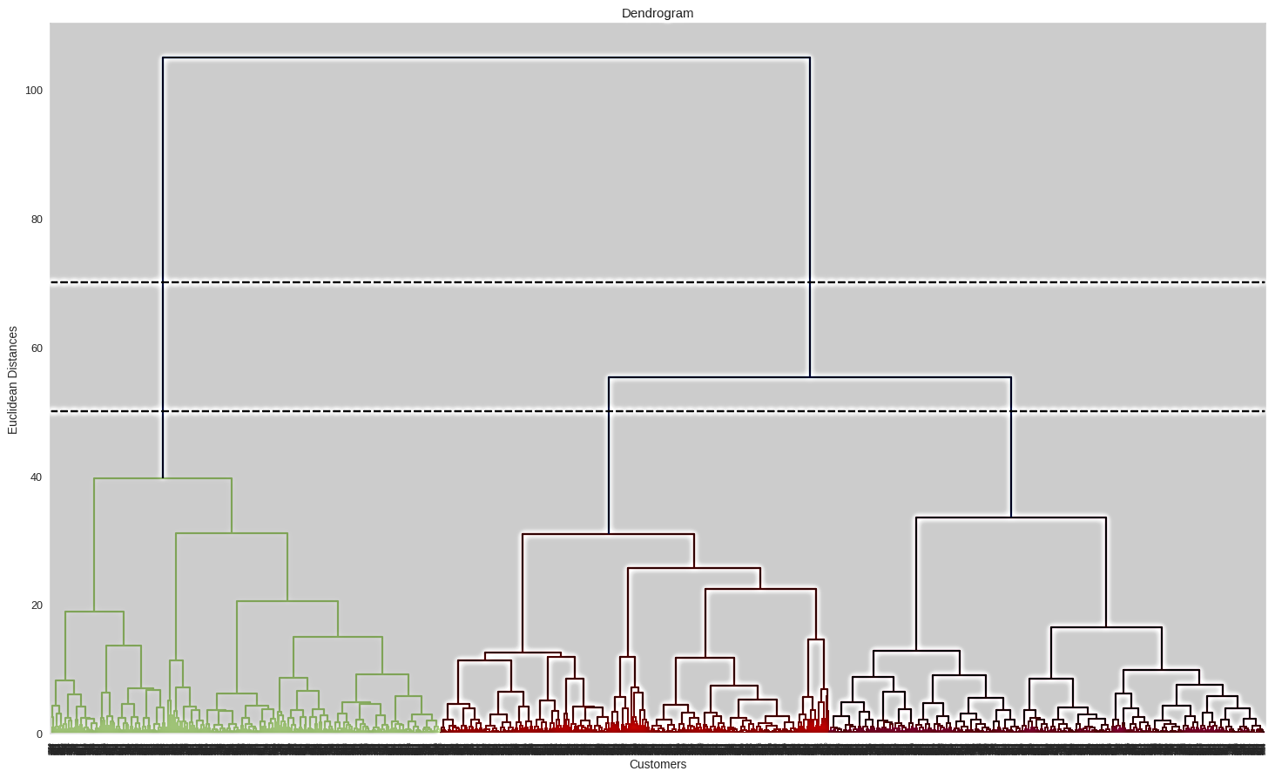
Hierarchical Clustering
The number of clusters will be the number of vertical lines which are being intersected by the line drawn using the threshold. The larger threshold (y=70) results in 2 clusters while the smaller (y=50) results in 3 clusters

Slide 38
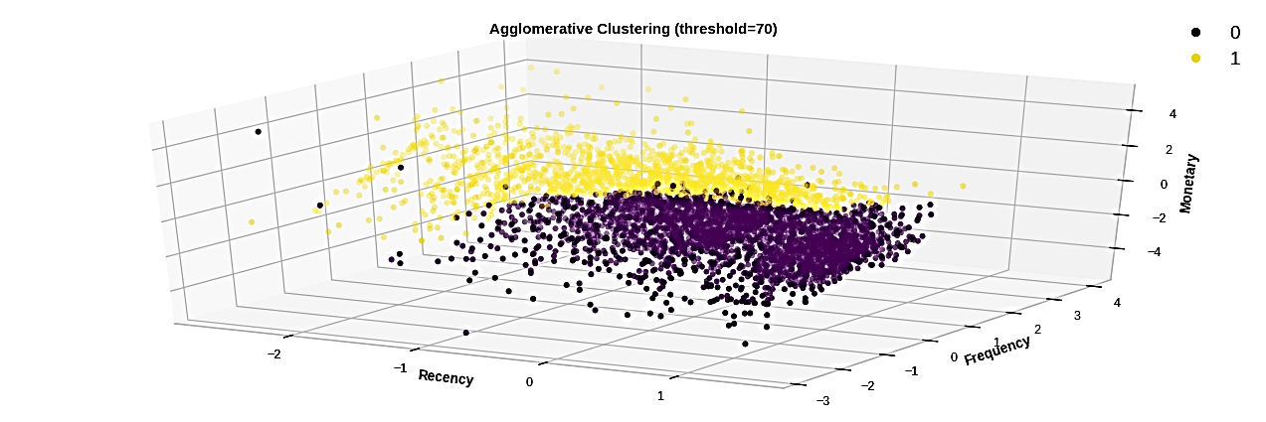
Hierarchical Clustering
Fitting hierarchical clustering with number of clusters based on dendogram distance threshold = 70

Slide 39
CONCLUSION
We started with a quantile based simple segmentation model first then moved to more complex models because simple implementation helps having a first glance at the data and know where/how to exploit it better.
We didn't obtain a clearly separated clusters as the Cluster assignments are muddled. Segments depend on how the business plans to use the results, and the level of granularity they want to see in the clusters. Based on that various methods of clustering can be further exploited whether applied on RFM variables or directly on the transactional dataset.

Slide 40
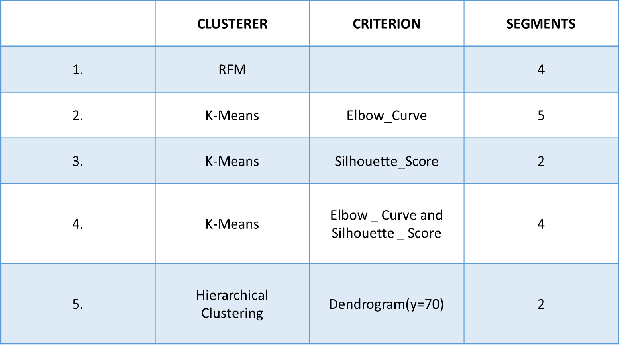
RFM QUANTILE CUT
1. Lost poor customers
2. Lost loyal customers
3. Good customers
4. Best customers
K-MEANS (2 CLUSTERS)
1. Best customers
2. Lost poor customers K-MEANS (4 CLUSTERS)
1. Losing loyal customers
2. Best customers
3. Lost poor customers
4. Recently visited average customers
K-MEANS (5 CLUSTERS)
1. Lost poor customer
2. Best customers
3. Recently visited average customers
4. Losing loyal customers
5. Average customers
AGGLOMERATIVE (2 CLUSTERS)
1. Average customers
2. Best customers

Slide 41
EDA Observations
1.United Kingdom has most number of orders With a count of more than 16000.
2.First country with high quantity of orders is from Netherlands with a count of 80 above
3.The product with high quantity of order is Paper Craft Little Birdie with a count of 80000.
4.Product that made most of the profit in terms of revenue is Paper Craft Little Bride. With more than the count of 160000.
5.The customer id with most number of cancellations is 149110.
6. Country with highest number of cancellation is United Kingdom with a Count of more than 7000.

Slide 42
Thanks

